Slide 1
ADHD, Self-Regulation, and
Executive Functioning: Theory and Implications for Management
Russell A. Barkley, Ph.D.
Clinical Professor of Psychiatry
Medical University of South Carolina
Charleston, SC
©Copyright by Russell A. Barkley, Ph.D., 2012
Sources:
Barkley, R. A. (in press). Executive Functions: What They Are, How They Work, and Why They Evolved. New York: Guilford Press.
Barkley, R. A. (2011). The Barkley Deficits in Executive Functioning Scale. New York: Guilford.
Barkley, R. A. (1997/2001) ADHD and the Nature of Self-Control. New York: Guilford Press
Email: drbarkley@russellbarkley.org
Website: russellbarkley.org

Slide 2
Dr. Barkley’s Disclosure
Retirement Pension: State of Massachusetts (UMASS Medical School)
Speaking Fees Received From (for past 12 months):
  University of Alabama, Student Disabilities Service, ADHD Conference, Tuscaloosa, AL
  Annual Conference on Learning Disabilities, University of Maryland, Shady Grove, MD
  Canadian Attention Deficit Disorders Resource Alliance (Toronto)
  J&K Seminars, Lancaster, PA
  Windsor-Essex County LD Association (Windsor, Canada)
  Alberta Learning Disabilities Association (Edmonton, Canada)
  Educational Fundacion Activa, Madrid, Spain
  TDAH Association, Barcelona, Spain
  Premier Educational Seminars, Inc. (PESI)
ADHD Network, Rotterdam, The Netherlands
Cincinnati Children’s Hospital, Ohio & Springer School of Cincinnati, OH
LDA Life and Learning Services, Rochester, NY
Assoc. for Training & Personal Development, Bucharest, Romania
Royalties:
  Guilford Publications (books, videos, newsletter)
  Jones & Bartlett Publishers (books & products)
  J & K Seminars (videotapes), New England Educational Institute (audiotapes), PESI (CDs)
  ContinuingEdCourses.net (internet CE courses), PsychContinuingEd.com
Speaker for: Eli Lilly, Shire (The Netherlands)
Consultant for: Eli Lilly, Theravance

Slide 3
Does ADHD = EFDD????
(Executive Function Deficit Disorder)

Slide 4
The Neuro-Anatomy and Neuropsychology of ADHD Virtually Guarantee It!

Slide 5
The Prefontal Cortical Networks Involved in EF Are Also the Networks Implicated in Self-Regulation and in ADHD
The frontal-striatal circuit: Associated with deficits in response suppression, freedom from distraction, working memory, organization, and planning, known as the “cool” or “what” EF network
The frontal-cerebellar circuit: Associated with motor coordination deficits, and problems with the timing and timeliness of behavior, known as the “when” EF network
The frontal-limbic circuit: Associated with symptoms of emotional dyscontrol, motivation deficits, hyperactivity-impulsivity, and proneness to aggression, known as the “hot” or “why” EF network
Nigg, J. T., & Casey, B. (2005). An integrative theory of attention-deficit/hyperactivity disorder based on the cognitive and affective neurosciences. Development and Psychology, 17, 785-806.
Castellanos, X., Sonuga-Barke, E., Milham, M., & Tannock, R. (2006). Characterizing cognition in ADHD: Beyond executive dysfunction. Trends in Cognitive Science, 10, 117-123.
Sagvolden, T., Johansen, E. B., Aase, H., & Russell, V. A. (2005). A dynamic developmental theory of attention-deficit/hyperactivity disorder (ADHD) predominantly hyperactive-impulsive and combined subtypes. Behavioral and Brain Sciences, 28, 397-408.

Slide 6
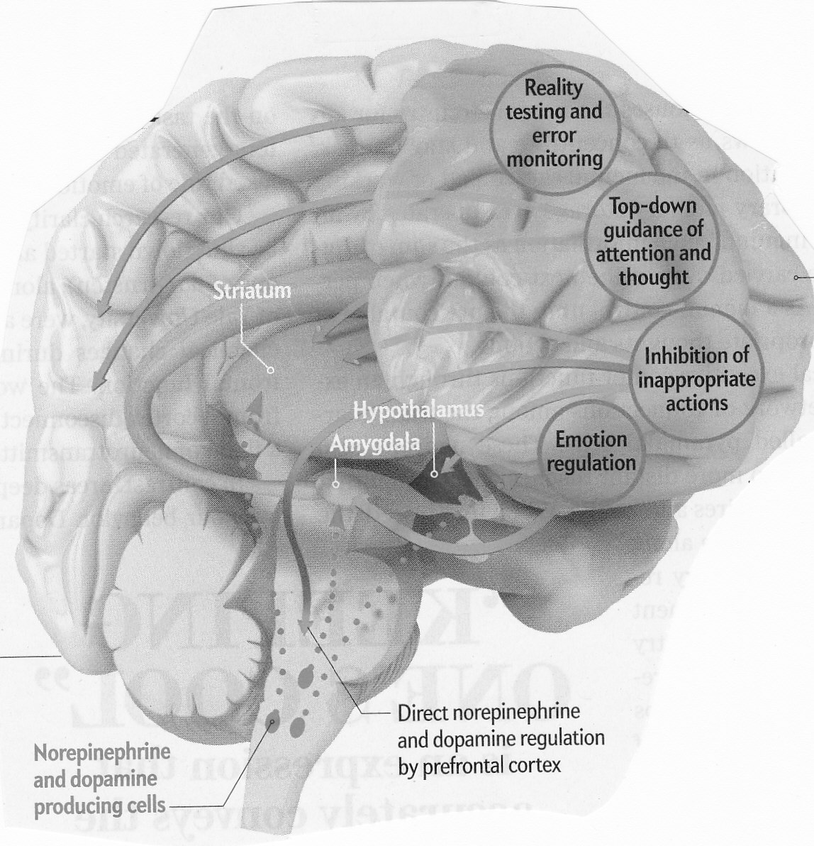
Executive Brain Networks

Slide 7
How Does ADHD Fit Into EF?
EF Comprises a Single Domain that Can Be Usefully Subdivided into two Broad Dimensions
Inhibition:
Motor,
Verbal,
Cognitive &
Emotional
Meta-Cognition:
Nonverbal WM
Verbal WM
Planning/Problem-solving
Emotional self-regulation
Where does ADHD fit into them?
Hyperactivity-
Impulsivity
Inattention

Slide 8
Executive Functioning:
Nature and Problems
From R. A. Barkley (2012). The Executive Functions: What They Are, How They Work, and Why They Evolved. New York: Guilford Press

Slide 9
Problems with the EF Construct
Lacks any consensus definition
Considered to be a meta-construct serving as an “umbrella” term for a set of more specific components
Assessment of EF nearly always employs “cold” cognitive psychometric tests. But tests of EF are problematic for various reasons
  Are unreliable and often poorly normed
  Lack ecological validity
    do not correlate with EF rating scales or observations
  Do not predict impairment in major domains of life in which EF is important for effective functioning;
  EF ratings do predict impairment
There is no accepted theory of EF nor is EF placed within its evolutionary context – why have EF?

Slide 10
Current Paradox
ADHD is a disorder of brain networks that contribute to EF – so it has to be an EF disorder
But only 35-50% or fewer ADHD cases are impaired on EF psychometric tests (>93rd %)
Yet 86-98% of clinical-referred adults with ADHD are impaired on rating scales of EF in daily life as are 65-75% of ADHD children by adulthood with persistent ADHD.
EF tests have low or no significant relationships with EF ratings in daily life
  0-10% of shared variance between tests & ratings
  less than 20% for best combination of EF tests
EF tests and EF ratings are NOT measuring the same construct

Slide 11
Study of clinic-referred adults with ADHD
(Barkley & Murphy, 2010)
From Barkley, R. A., & Murphy, K. R. (2010). Impairment in occupational functioning and adult ADHD: The predictive utility of executive function (EF) ratings vs. EF tests. Archives of Clinical Neuropsychology, 25, 157-173.

Slide 12
Group differences on EF scales
ADHD-P = Persistent ADHD, All p values < .001
ADHD-NP = Nonpersistent ADHD
Control = Community Control Group
Barkley, R. A., & Fischer, M. (2011). Predicting impairment in occupational functioning in hyperactive children as adults: Self-reported executive function (EF) deficits vs. EF tests. Developmental Neuropsychology, 36(2), 137-161..

Slide 13
Which Method of Assessing EF is the Most Valid?
EF scales predict up to 45% of variance in global self-rated impairment and 20% in other-rated impairment
EF tests predict up to 6% in global self-rated impairment and 7% in other-ratings
Overall, scales predict 2-20% of variance in work history measures averaging 11%
Overall, tests predict 2-18% of variance in work history measures averaging 6.8%
EF ratings predict a wider array of occupational problems than do EF tests
If predicting impairment is an index of validity of measurement, EF scales out-predict EF tests

Slide 14
What’s Wrong with EF Tests?
Cannot capture EF as it functions to enact and sustain goal-directed behavior across long spans of time
  Most tests last just 15-30 minutes each
Do not capture the important social factors that EF evolved to address
  Reciprocity, cooperation, mutual support
Do not evaluate emotional self-regulation
Fail to capture the link between EF and culture (both its creation and adoption)

Slide 15
How to Resolve the Problems?
Make self-regulation the core of EF
  A self-directed action
  Intended to alter subsequent behavior
  So as to change the probability of a future event or consequence
Understand that humans use at least 7 different self-directed actions for self-regulation to achieve delayed goals
Each type of self-directed action can be considered an executive function (or specific component)
They develop in a step-wise sequence
These exist to address the problems and opportunities involved in social (group) living
View EF as a hierarchy of levels (in biology - an extended phenotype) similar to Michon’s model of driving

Slide 16
Building a Theory of EF and ADHD:
Linking Inhibition, Self-Control, and the Executive Functions

Slide 17
What is Self-Regulation?
Self-regulation can be defined as:
Any action a person directs toward one’s self (a behavior-to-the-self)
So as to change their own subsequent behavior from what they otherwise would have done
In order to change the likelihood of a future consequence
You cannot direct an action at yourself without inhibiting your responses to the ongoing environment – they are mutually exclusive

Slide 18
What is EF?
An executive function can be defined as a major type of action-to-the-self (a type of self-regulation)
There are 6-7 major types of EFs:
  Self-Awareness (meta-cognition)
  Inhibition and interference Control
  Nonverbal and verbal working memory
  Emotional - motivational self-regulation
  Planning and problem-solving
All can be redefined as actions-to-the-self
Each likely develops by behavior being turned on the self and then internalized (privatized, inhibited)
They likely develop in a step-wise hierarchy - Each needs the earlier ones to function well

Slide 19
The EFs Create Four Developmental Transitions in What is Controlling Behavior
External Mental (private or internal)
Others Self
Temporal now Anticipated future
Immediate Delayed gratification
(Decreased Temporal Discounting of Delayed Consequences)

Slide 20
Building an Extended Phenotype of Executive Functioning

Slide 21
Michon’s Model of Driving
Level IV: Strategic Abilities
i.e., Purpose or goals for using the car, best routes through traffic to attain the goals, time likely needed to attain each goal, knowledge needed to enact the plan effectively (weather, traffic, construction, known accidents, etc.)
Level III: Tactical Abilities
i.e., abilities required to operate the vehicle on roadways in the presence of and interactions/conflicts with other drivers and their vehicles, such as driving laws, knowledge of safe driving tactics, etc.
Level II: Operational Abilities
i.e., familiarity with and sound management of the vehicle and its components such as steering, braking, acceleration, signaling, mirrors, seat belts, other safety equipment [ex. Driving a car in an empty parking lot]
Level I: Basic Cognitive Abilities Required to Drive
i.e., normal reaction time; visual field perception; motor speed, agility, coordination, and range of motion; visuo-spatial reasoning; hearing; language and reading abilities, etc.

Slide 22
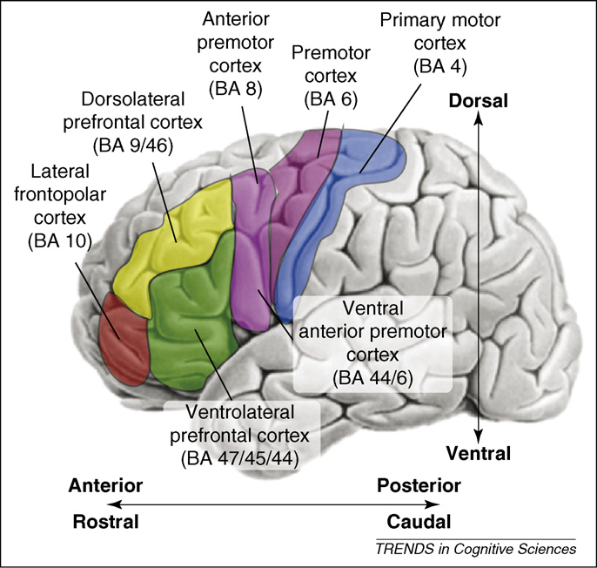
Anterior-posterior (rostral-caudal) hierarchy of cognitive control of behavior
Reliance on Cultural Methods and Products
Social Complexity: Interactions & Networks
Increasingly Abstract, Longer-Term Goals
Increased Valuing of Delayed Outcomes
Extended Time Horizon
Extended Space Horizon
Increased Behavioral Complexity/Hierarchies
Neurological Maturation
Figure 1. Badre, D. (2008). Trends in Cognitive Sciences, 12(5), 193-200.

Slide 23
Executive Functioning - Defined
  EF is the use of self-directed actions (self-regulation) to choose goals, and to select, enact, and sustain actions across time toward those goals, usually in the context of others and often relying on social and cultural means. This is done for the maximization of one’s longer-term welfare as the person defines that to be.
  (Barkley, in press)

Slide 24
Barkley’s Model of EF
Level IV: Strategic – Cooperative Abilities
i.e., Underlies human coordinated group activities in which goals can be attained that are not possible for any individual. Underlies cooperative ventures, division of labor, formation of communities and governments
Level III: Tactical – Reciprocal Abilities
i.e., Underlies human social exchange, turn taking, reciprocity, promise keeping. Basis of economic behavior (trading); Underlies ethics, social skills and etiquette; Basis for legal contracts
Level II: Methodical – Self-Reliant Abilities
Essential for daily adaptive functioning, self-care, and social self-defense
i.e., Self-Organization and Problem-Solving, Self-Management to Time, Self-Restraint, Self-Motivation, Self-Regulation of Emotions
Level I: Instrumental – Self-Directed Abilities
i.e., self-awareness, executive inhibition and interference control, nonverbal and verbal working memory, planning, problem-solving, self-motivation, emotion regulation

Slide 25
6 Level Hierarchy of EF
Extended Utilitarian
Strategic - Cooperative
Tactical - Reciprocal
Methodical – Self-Reliant
Instrumental – Self-Directed
Pre-Executive (non-EF)

Slide 26
c
c
c
The Extended Phenotype Model of Executive Functioning
c
Extended Utilitarian
Strategic -- Cooperative
Tactical -- Reciprocal
Methodical – Self-Reliant
Instrumental – Self-Directed
Pre-Executive

Slide 27
Understanding EF Disorders
PFC Disorders disrupt the 5 levels of EF/SR but especially the tactical and higher levels thereby creating a disorder of self-regulation across time
They create “Time Blindness” or a “Temporal Neglect Syndrome” (Myopia to the Future)
They cause a contraction of the EF hierarchy the extent of which is based on severity of interference with or injury to the PFC
They cause a reduction in the 8 developmental capacities (time, space, motivation, behavioral, abstract, social, cultural, etc.)
They adversely affect the capacity to hierarchically organize nested sets of goal directed behavior across time to anticipate the future and to pursue one’s long-term goals and self-interests (welfare and happiness)

Slide 28
6 Level Hierarchy of EF
PFC
Disorders
Extended Utilitarian
Strategic - Cooperative
Severe PFC Injury
Tactical - Reciprocal
Methodical – Self-Reliant
Instrumental – Self-Directed
Pre-Executive (non-EF)

Slide 29
Anterior-posterior (rostral-caudal) hierarchy of cognitive control of behavior
Reliance on Cultural Methods and Products
Social Complexity: Interactions & Networks
ADHD
Increasingly Abstract, Longer-Term Goals
Increased Valuing of Delayed Outcomes
Extended Time Horizon
Extended Space Horizon
Increased Behavioral Complexity/Hierarchies
Neurological Maturation
Figure 1. Badre, D. (2008). Trends in Cognitive Sciences, 12(5), 193-200.

Slide 30
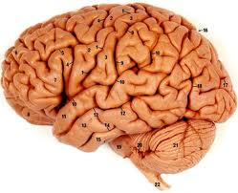
The Brain as a Knowledge vs. Performance Device
ADHD
Knowledge
Performance

Slide 31
Understanding ADHD
ADHD disrupts the 5 levels of EF/SR but especially the tactical and higher levels thereby creating a disorder of self-regulation across time
ADHD can be considered as “Time Blindness” or a “Temporal Neglect Syndrome” (Myopia to the Future)
It adversely affects the capacity to hierarchically organize behavior across time to anticipate the future and to pursue one’s long-term goals and self-interests (welfare and happiness)
It’s not an Attention Deficit but an Intention Deficit (Inattention to mental events & the future)

Slide 32
Understanding ADHD
It’s a Disorder of:
Performance, not skill
Doing what you know, not knowing what to do
The when and where, not the how or what
Using your past at the “point of performance”
The point of performance is the place and time in your natural settings where you should use what you know (but may not)

Slide 33
Implications for Treatment
Teaching skills is inadequate
The key is to design prosthetic environments around the individual to compensate for their EF deficits
Therefore, effective treatments are always those at the “point-of-performance”
The EF deficits are neuro-genetic in origin
Therefore, medications may be essential for most (but not all) cases – meds are neuro-genetic therapies
But some evidence suggests some EFs may also be partly responsive to direct training
While ADHD creates a diminished capacity: Does this excuse accountability?
  (No! The problem is with time and timing, not with consequences)

Slide 34
More Treatment Implications
Behavioral treatment is essential for restructuring natural settings to assist the EFs
  They provide artificial prosthetic cues to substitute for the working memory deficits (signs, lists, cards, charts, posters)
  They provide artificial prosthetic consequences in the large time gaps between consequences (accountability) (i.e., tokens, points, etc.)
  But their effects do not generalize or endure after removal because they primarily address the motivational deficits in ADHD
The compassion and willingness of others to make accommodations are vital to success
A chronic disability perspective is most useful

Slide 35
How can we compensate for EF deficits?
By reverse engineering the EF system
Externalize important information at key points of performance
Externalize time and time periods related to tasks and important deadlines
Break up lengthy tasks or ones spanning long periods of time into many small steps
Externalize sources of motivation
Externalize mental problem-solving
Replenish the SR Resource Pool (Willpower)
Practice incorporating the 5 strategies for emotional regulation in daily life activities

Slide 36
Self-Regulatory Strength is a Limited Resource Pool
S-R Fuel Tank
(Willpower)
Inhibition & Self-Restraint
The pool increases in capacity with maturation.
Use of EF/SR reduces the pool. temporarily
Self-Management to Time (NV-WM)
Self-Organization & Problem-Solving (V-WM)
So Does:
Stress, Alcohol,
Drug Use, & Illness
Emotional Self-Regulation
Self-Motivation

Slide 37
Replenishing the EF/SR Resource Pool
Greater Rewards and Positive Emotions
S-R Fuel Tank
(Willpower)
Statements of Self-Efficacy and Encouragement
Regular limited practice using EF/SR and the Willpower Pool can increase later pool capacity. However, the capacity may eventually diminish once practice is terminated.
10 minute breaks between EF/SR tasks
3+ minutes of relaxation or meditation
Visualizing and talking about future rewards before and during SR demanding tasks
Routine physical exercise; Also
Glucose ingestion
Adapted from Bauer, I. M. & Baumeister, R. F. (2011). Self-regulatory strength. In K. Vohs & R. Baumeister (Eds.), Handbook of Self-Regulation (2nd ed.) (pp. 64-82). New York: Guilford Press

Slide 38
Conclusions
The EF/SR system is multi-leveled and arranged in a hierarchy over maturation
ADHD disrupts behavioral inhibition and the internalization of the instrumental self-directed EFs producing a cascading of deficits into higher levels of EF
By disrupting EF/SR, ADHD affects:
  Self-restrain or inhibit behavior, thoughts, words, emotions
  Self-manage to time; anticipate and prepare for the future
  Self-organize and problem solve across time
  Self-motivate across time
  Self-regulate emotions across time

Slide 39
Conclusions
Behavior in people with ADHD cannot be hierarchically organized and sustained in support of longer term goals and welfare
This results in a serious and pervasive disorder of self-regulation across time and settings and impaired social functioning (reciprocity, cooperation, and mutualism)
Preventing them from dealing effectively with the probable future and pursuing one’s long-term goals and welfare
Thereby requiring the design of prosthetic environments that compensate for EF/SR deficits while using neuro-genetic medicines to temporarily improve or normalize the instrumental self-directed EFs

